Slide 1
caTissue Suite 2.0

Slide 2
New features in caTissue Suite 2.0
Global Specimen Identifier
CTRP Integration
C3PR Integration
Standard operating procedures (SOPs)

Slide 3
Global Specimen Identifier
The Global Specimen Identifier (GSID) provides a service that maintains the relationships between biospecimens across multiple applications to facilitate interoperability.
A NCI server will host this service.
Any caTissue instance can choose to consume this service to uniquely identify every specimen.

Slide 4
GSID model changes

Slide 5
CTRP Integration
CTRP is a source for records of Persons, Organizations, Protocol Abstractions, and the Correlations between these entities.
caTissue will be enhanced to allow users to search for these entities, pull them into caTissue, and refer to them when performing activities within caTissue.
The latest data will be fetched from CTRP NCI Enterprise Services (NES) whenever appropriate for business workflows.

Slide 6
Person and Study registration Model changes

Slide 7
C3PR Integration
C3PR is a source for participant information and protocol registrations.
caTissue will retrieve participant and protocol registration information from C3PR and store in its local database.
caTissue will use Subject Registration service backed by C3PR to store new registrations made in caTissue.

Slide 8
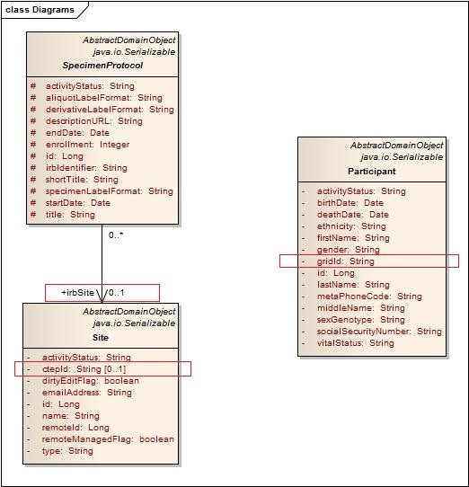
C3PR Integration Related Changes

Slide 9
Structured SOPs
Standard operating procedures (SOPs) are a series of defined steps that dictate how to procure or process biospecimens.
In caTissue 2.0, users will be able to manage and represent SOPs as series of dynamic events and associate them with Collection Protocols.
During collection, users can record SOP details and any deviations either to the variables within defined events that are part of the SOP, or modifications to the SOP itself

Slide 10
SOP Model changes

